Slide 1

What is a Random Forest Classifier?
Collection of individual and independent decision trees (aka the “forest”)
For a given object, each tree in the forest independently classifies the object
Final classification of the object is the majority vote from the forest
https://www.maiafinancial.com.au/wp-content/uploads/2016/09/iStock-506856658-resize-2mb-1024x682.jpg

Slide 2
Why Use a Random Forest Classifier?
Pros:
Binary-decision
Non-parametric: can use on data where true incidence or distribution of the variables is unknown
Works for data with both categorical and numerical data (binary and continuous data)
Versus a Single Decision Tree
Reduces risk of model overfitting
More stable/robust—better able to handle dataset variation
Cons:
Depending on complexity of dataset, algorithm can be computationally expensive

Slide 3
Danielle’s References
Datasets obtained from:
2013-2014 NHANES
https://www.kaggle.com/cdc/national-health-and-nutrition-examination-survey
https://wwwn.cdc.gov/Nchs/Nhanes/Default.aspx
UCI Data
https://data.world/uci/heart-disease
Random Forest algorithm description and tutorials
https://stackabuse.com/random-forest-algorithm-with-python-and-scikit-learn/
https://medium.com/@hjhuney/implementing-a-random-forest-classification-model-in-python-583891c99652
https://towardsdatascience.com/random-forest-in-python-24d0893d51c0
https://jakevdp.github.io/PythonDataScienceHandbook/05.08-random-forests.html
http://blog.citizennet.com/blog/2012/11/10/random-forests-ensembles-and-performance-metrics
https://www.kdnuggets.com/2019/01/random-forests-explained-intuitively.html

Slide 4
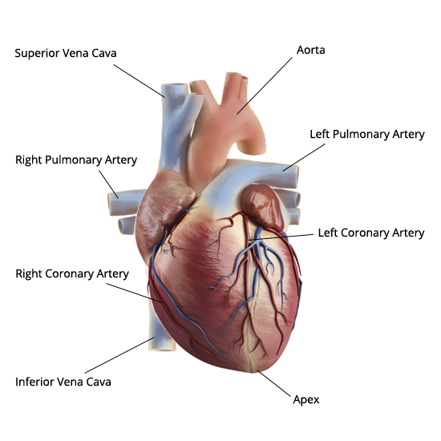
https://leelammavarghese.files.wordpress.com/2014/06/human-heart-external-view.jpg

Slide 5

https://www.joshgitalis.com/wp-content/uploads/2013/01/Cardiovascular_System.jpg

